Slide 1
Parallelizing the Naughty Dog engine using fibers Christian Gyrling Lead Programmer @ Naughty Dog

Slide 2
Evolution of our PS4 engine
Solve the issues and limitations with our job system
All code need to be able to be jobified
Fibers
CPU utilization is nowhere near 100%!
Process multiple frames at once
Memory lifetime

Slide 3
Background: PS3 Engine
Single threaded engine (30Hz)
Game logic followed by command buffer setup
SPUs were used as worker threads
Most engine systems were running on the SPUs
Very little gameplay code ran on SPUs

Slide 4
Issues with our PS3 job system
Jobs always ran to completion without ever yielding.
Complex to move gameplay onto SPUs
User of the job system had to allocate/free resources
Job definitions and job lists (lifetime issues)
State of a job list was confusing
Possible to add jobs while the list was running/stopped
Job synchronization through marker index in job array
Had to reset job array between uses because the index would get reused

Slide 5
Design goals for new job system
Allow jobifying code that couldn’t be moved to SPUs
Jobs can yield to other jobs in the middle of execution
Example: Player update with kick and wait for ray casts
Easy to use API for gameplay programmers
No memory management for the user
One simple way to synchronize/chain jobs
Performance was secondary to ease-of-use of the API

Slide 6
Fibers
Like a partial thread
User provided stack space
Small context containing state of fiber and saved registers
Executed by a thread
Cooperative multi-threading (no preemption)
Switching between fibers is explicit (sceFiberSwitch on PS4)
Other operating systems have similar functionality
Minimal overhead
No thread context switching when changing between fibers. Only register save/restore. (program counter, stack pointer, gprs…)

Slide 7
Our job system
6 worker threads
Each one is locked to a CPU core
A thread is the execution unit, the fiber is the context.
A job always executes within the context of a fiber
Atomic counters used for synchronization
Fibers
160 fibers (128 x 64 KiB stack, 32 x 512 KiB stack)
3 job queues (Low/Normal/High priority)
No job stealing

Slide 8
Job System
Worker Thread
Jobs
Worker Thread
Worker Thread
Worker Thread
Worker Thread
Fiber
Worker Thread
Fiber
Fiber
Fiber
Job Queue
Fiber
Fiber
Fiber
Fiber
Fiber
Fiber
Fiber
Fiber
Fiber
Fiber
Fiber
Fiber
Fiber
Fiber
Fiber Pool - 160 Fibers
Stack & Registers
3 Job Queues
Low, Normal, High
Priority
6 Worker Threads

Slide 9
Job System
Worker Thread
Job Queue
Fiber

Slide 10
Job System
Worker Thread
Job Queue
Jobs always execute inside a fiber context

Slide 11
Job System
Worker Thread
Job Queue
Jobs can add more jobs

Slide 12
Job System
Worker Thread
Wait List
Job Queue
1
A waiting job is put in a wait list associated with the counter waited on

Slide 13
Job System
Worker Thread
Wait List
Job Queue
1
A new fiber is used to allow another job to begin executing.
The stack of the waiting job is preserved in the fiber
Fiber Pool

Slide 14
Job System
Worker Thread
Wait List
Job Queue
1
The new fiber takes the next job from the job queue and begins executing it

Slide 15
Job System
Worker Thread
Wait List
Job Queue
0
When a job completes it will decrement an associated counter and wake up any waiting jobs

Slide 16
Job System
Worker Thread
Wait List
Job Queue
0
When a job is resumed we first free the current fiber
Fiber Pool

Slide 17
Job System
Worker Thread
Wait List
Job Queue
0
We then switch to the waiting fiber and resume execution

Slide 18
Job System Details
Worker threads are locked to cores
Avoid context switches and unwanted core switching
Kernel threads can otherwise cause ripple effects across the cores
ndjob::WaitForCounter(counter, 0)
Can be waited on by any job (moves fiber to wait list)
Only way of synchronizing jobs
Being able to yield a job at any time is extremely powerful!
~800-1000 jobs per frame in ‘The Last of Us: Remastered’

Slide 19
Everything is a job
Game object updates
Animation updates & joint blending
Ray casts
Command buffer generation
Except ”I/O threads” (sockets, file I/O, system calls…)
These are system threads
Implemented like interrupt handlers (Read data, post new job)
Always waiting and never do expensive processing of the data

Slide 20
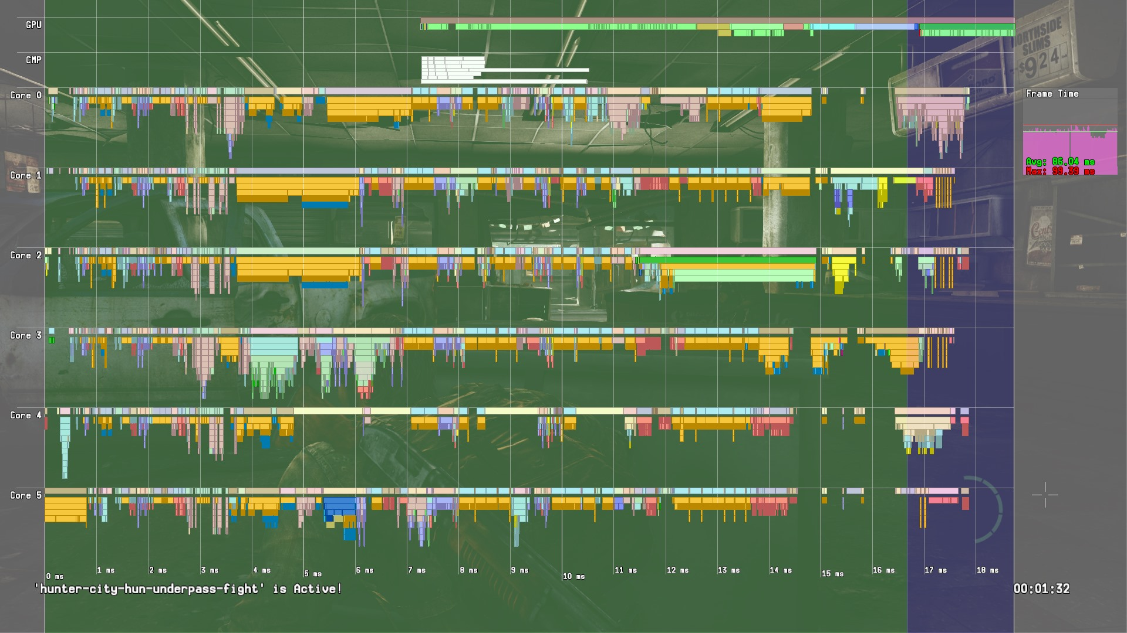

Slide 21
Worker Threads

Slide 22
Jobs

Slide 23
Per-job callstack

Slide 24
Example – Animate All Objects
Object g_Objects[100];
void AnimateObject(void* pObj)
{
…
}
void AnimateAllObjects()
{
for (int objIndex = 0; objIndex < 100; ++objIndex)
{
AnimateObject(&g_Objects[objIndex ]);
}
}

Slide 25
Example – Animate All Objects
Object g_Objects[100];
void AnimateObject(void* pObj)
{
…
}
void AnimateAllObjects()
{
for (int objIndex = 0; objIndex < 100; ++ objIndex )
{
AnimateObject(&g_Objects[objIndex]);
}
}

Slide 26
Example – Animate All Objects
Object g_Objects[100];
JOB_ENTRY_POINT(AnimateObjectJob)
{
…
}
void AnimateAllObjects()
{
JobDecl jobDecls[100];
for (int jobIndex = 0; jobIndex < 100; ++jobIndex)
{
jobDecls[jobIndex] = JobDecl(AnimateObjectJob, &g_Objects[jobIndex]);
}
Counter* pJobCounter = NULL;
RunJobs(&jobDecls, 100, &pJobCounter);
WaitForCounterAndFree(pJobCounter, 0);
}

Slide 27
Example – Animate All Objects
Object g_Objects[100];
JOB_ENTRY_POINT(AnimateObjectJob)
{
…
}
void AnimateAllObjects()
{
JobDecl jobDecls[100];
for (int jobIndex = 0; jobIndex < 100; ++jobIndex)
{
jobDecls[jobIndex] = JobDecl(AnimateObjectJob, &g_Objects[jobIndex]);
}
Counter* pJobCounter = NULL;
RunJobs(&jobDecls, 100, &pJobCounter);
WaitForCounterAndFree(pJobCounter, 0);
}
Jobs can be created on the stack

Slide 28
Example – Animate All Objects
Object g_Objects[100];
JOB_ENTRY_POINT(AnimateObjectJob)
{
…
}
void AnimateAllObjects()
{
JobDecl jobDecls[100];
for (int jobIndex = 0; jobIndex < 100; ++jobIndex)
{
jobDecls[jobIndex] = JobDecl(AnimateObjectJob, &g_Objects[jobIndex]);
}
Counter* pJobCounter = NULL;
RunJobs(&jobDecls, 100, &pJobCounter);
WaitForCounterAndFree(pJobCounter, 0);
}
Fill in the job declarations with entry point and parameter

Slide 29
Example – Animate All Objects
Object g_Objects[100];
JOB_ENTRY_POINT(AnimateObjectJob)
{
…
}
void AnimateAllObjects()
{
JobDecl jobDecls[100];
for (int jobIndex = 0; jobIndex < 100; ++jobIndex)
{
jobDecls[jobIndex] = JobDecl(AnimateObjectJob, &g_Objects[jobIndex]);
}
Counter* pJobCounter = NULL;
RunJobs(&jobDecls, 100, &pJobCounter);
WaitForCounterAndFree(pJobCounter, 0);
}
The job entry point is easily defined

Slide 30
Example – Animate All Objects
Object g_Objects[100];
JOB_ENTRY_POINT(AnimateObjectJob)
{
…
}
void AnimateAllObjects()
{
JobDecl jobDecls[100];
for (int jobIndex = 0; jobIndex < 100; ++jobIndex)
{
jobDecls[jobIndex] = JobDecl(AnimateObjectJob, &g_Objects[jobIndex]);
}
Counter* pJobCounter = NULL;
RunJobs(&jobDecls, 100, &pJobCounter);
WaitForCounterAndFree(pJobCounter, 0);
}
Schedule all jobs and receive a counter that you can wait for

Slide 31
Example – Animate All Objects
Object g_Objects[100];
JOB_ENTRY_POINT(AnimateObjectJob)
{
…
}
void AnimateAllObjects()
{
JobDecl jobDecls[100];
for (int jobIndex = 0; jobIndex < 100; ++jobIndex)
{
jobDecls[jobIndex] = JobDecl(AnimateObjectJob, &g_Objects[jobIndex]);
}
Counter* pJobCounter = NULL;
RunJobs(&jobDecls, 100, &pJobCounter);
WaitForCounterAndFree(pJobCounter, 0);
}
Wait for all jobs by waiting for the counter to be zero. Job goes to sleep.

Slide 32
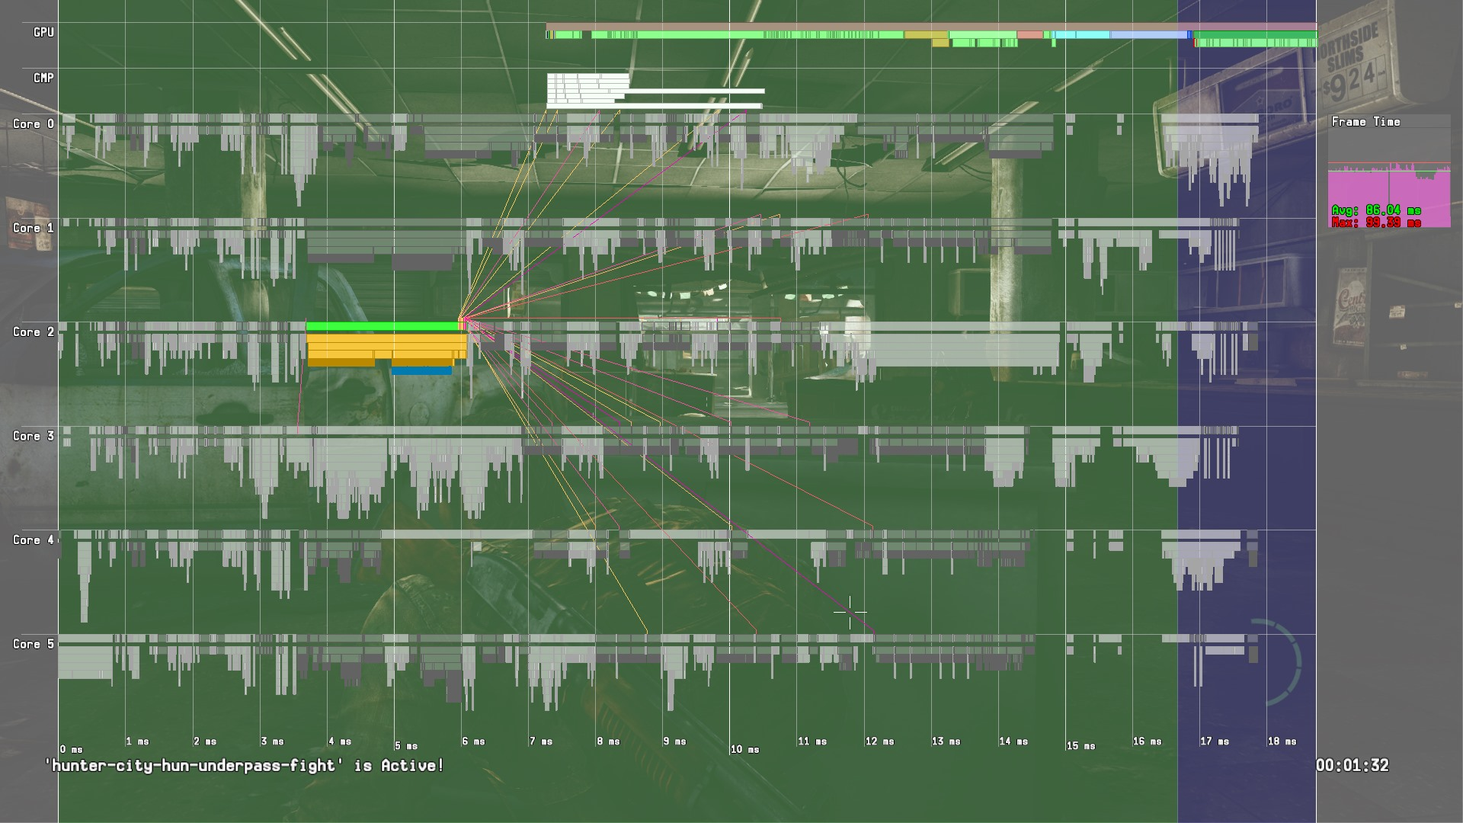
Lots of jobs are kicked and then waited on

Slide 33
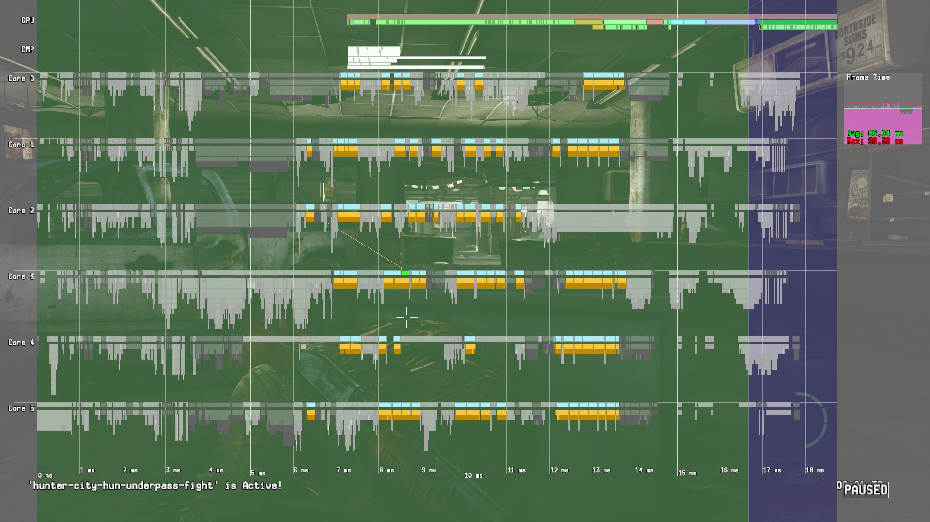
Jobs executing in parallel

Slide 34
The waiting job wakes up and continues executing

Slide 35
Pros of new job system
Extremely easy to jobify existing gameplay updates
Deep call stacks are no problem
Having one job wait for another is straight-forward
WaitForCounter(…)
Super-lightweight to switch fibers
System supported operation - sceFiberSwitch() on PS4
Save the program counter and stack pointer…
…and all the other registers
Restore the program counter and stack pointer…
…and all the other registers

Slide 36
Cons of new job system
System synchronization primitives can no longer be used
Mutex, semaphore, condition variables…
Locked to a particular thread. Fibers migrate between threads
Synchronization has to be done on the hardware level
Atomic spin locks are used almost everywhere
Special job mutex is used for locks held longer
Puts the current job to sleep if needed instead of spin lock

Slide 37
Support For Fibers
Fibers and their call stacks are viewable in the debugger
Can inspect fibers just like you would inspect threads
Fibers can be named/renamed
Indicate current job
Crash handling
Fiber call stacks are saved in the core dumps just like threads

Slide 38
Support For Fibers…
Fiber-Safe Thread Local Storage (TLS) Optimizations
Issue: TLS address is allowed to be cached for the duration of the function by default. Switch fiber in the middle of function and you wake up with wrong TLS pointer. ☹
Currently not supported by Clang
Workaround: Use separate CPP file for TLS access
Use adaptive mutexes in job system
Jobs can be added from normal threads
Spin locks -> Dead locks
Spin and attempt to grab lock before doing system call
Solves priority inversion deadlocks
Can avoid most system calls due to initial spin

Slide 39
Other job systems
Intel Thread Build Blocks (TBB) is popular
Solves dependencies between jobs and chaining but requires every job to execute until completion…
… unless you want context switching
OR allow job nesting while a job is waiting.
This will prevent the first job from resuming until the second job has completed.
A fiber-based job system has none of these issues

Slide 40
Moving on…
We have our new job system
All code can now be jobified
Let’s do it!

Slide 41
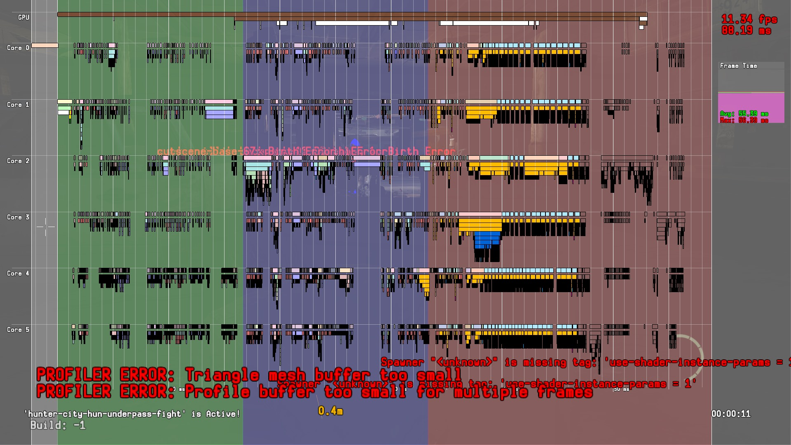
16.66 ms(60 fps)

Slide 42
33.33 ms(30 fps)

Slide 43
Less than 30 fps

Slide 44
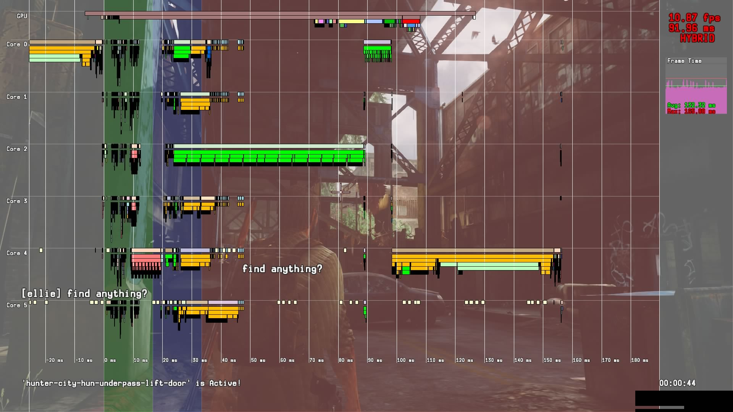
Initial Port
132 ms
Everything that was running on SPU on PS3 is now a job

Slide 45
Initial Port
But we have a new rendering engine.
132 ms
Everything that was running on SPU on PS3 is now a job

Slide 46
Jobify everything
55 ms
Game object updates and command buffer generation is now jobified

Slide 47
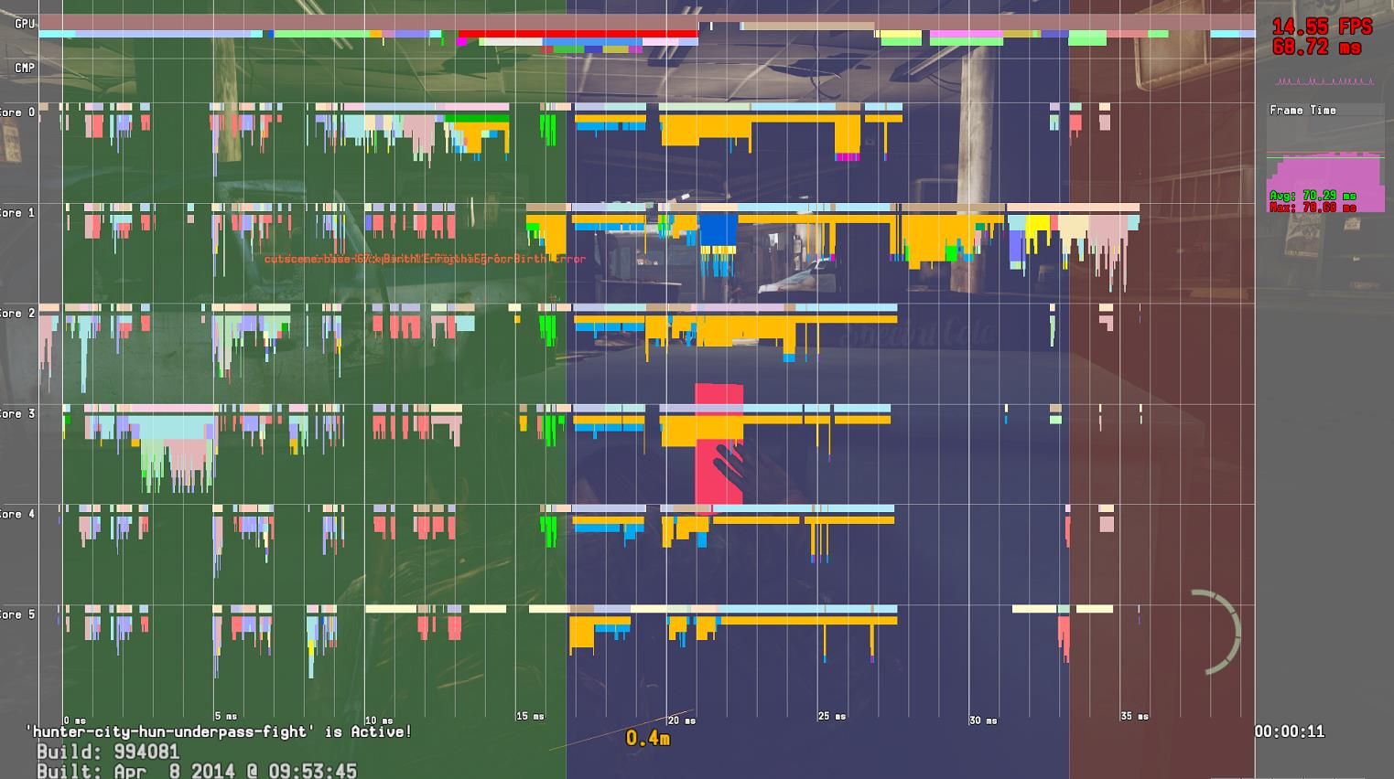
More jobs and fewer locks
36 ms
GPU bound due to most graphics features being implemented, but are very slow.
70 ms GPU frame

Slide 48
April 8th 2014
3 months until ship!

Slide 49
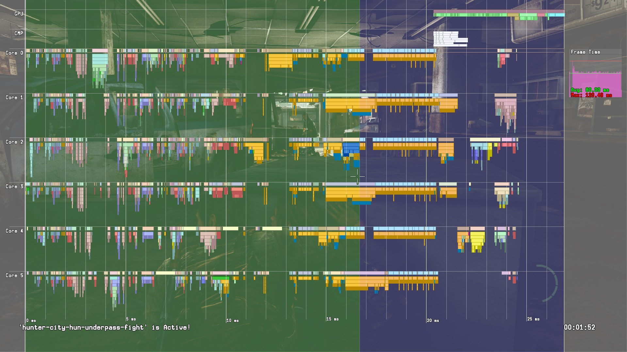
Diminishing returns…
25 ms

Slide 50
Harsh realization
Most systems are now jobified.
GPU optimizations are going really well
CPU bound
Critical path on CPU takes ~25 milliseconds.
Lots of idle time on CPU cores
At this point we are a little over 2 months away from shipping

Slide 52
Lots of medium/small holes on cores

Slide 53
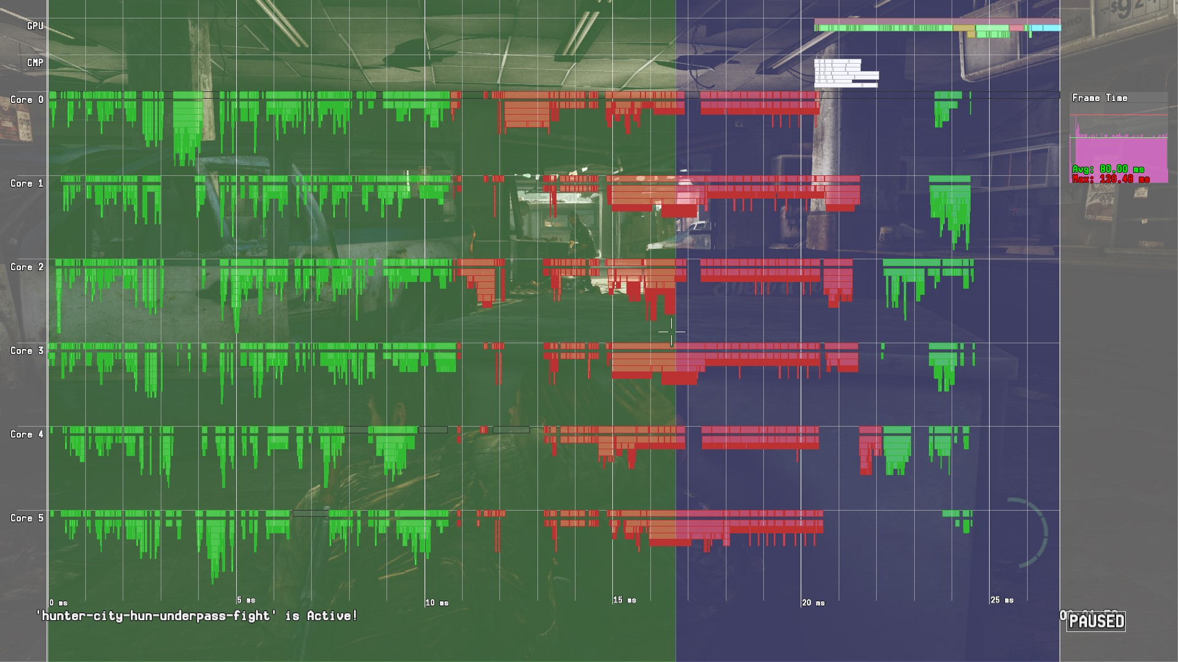
Game Logic
Rendering Logic

Slide 54
Is it possible to reach 60 fps?
We had ~100 ms worth of work to do on the CPU for a single frame
If we can manage to fill all the cores 100% of the time, then we can make it run at 60 fps.
16.66 ms of work * 6 cores -> ~100 ms of work
Ok, theoretically possible… but how do we do that?

Slide 55
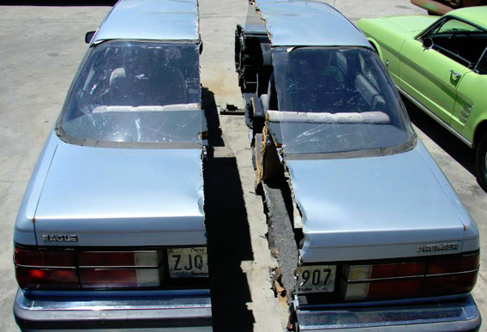
Let’s cut it in half!!!

Slide 56
How?
Current design
Game logic runs first
Rendering logic and command buffer generation runs after
New design
Run game and render logic at the same time
BUT processing different frames!

Slide 57
Engine pipeline – Feed forward
Game Logic
16.66 ms
Render Logic
16.66 ms
GPU Exec
16.66 ms
Frame 1

Slide 58
Engine pipeline – Feed forward
Game Logic
16.66 ms
Render Logic
16.66 ms
GPU Exec
16.66 ms
Frame 2
Frame 1

Slide 59
Engine pipeline – Feed forward
Game Logic
16.66 ms
Render Logic
16.66 ms
GPU Exec
16.66 ms
Frame 3
Frame 2
Frame 1

Slide 60
Frame centric design
Each stage is running completely independent
No synchronization required
A stage can process the next frame right away
Complexity in engine design is simplified
Very few locks needed due to parallelism
Locks are only used to synchronize within heavily jobified stage updates

Slide 61
Old Design

Slide 62
Old Design
Game Logic
Rendering Logic
25 ms

Slide 63
Old Design
25 ms

Slide 64
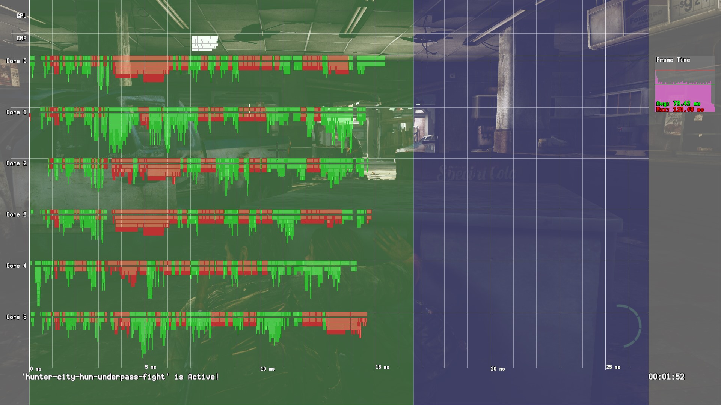
New Design
15.5 ms!!!
Ship it!

Slide 65
Memory allocation on PS3
Linear allocators
Contiguous block of memory + offset in block
Allocation is as simple as updating the offset
‘Free’ all allocations by setting the offset to 0
Single/Double/Triple frame
At the beginning of the frame we rotate to a new block and set the offset to 0
Works great when you process ONE frame at a time

Slide 66
Multi-frame difficulties
“When should I free my memory?”
Memory is consumed in a later asynchronous stage
“I need a new buffer every frame.”
“How many buffers do I need to rotate between to avoid memory stomping?”
“Which delta time should I use?”
Every programmer was solving the same problem
… often incorrectly
Hard to understand everything that is going on

Slide 67
Frames, frames, frames…
What is a ‘frame’ anyway?
Game logic frame, GPU frame, display frame?
Memory lifetime
When do I safely free memory?
Can we double/triple buffer memory?
What does the even mean now?
Need a new way of thinking about frames

Slide 68
Our definition of a frame
“A piece of data that is processed and ultimately displayed on screen”
The main point here is ‘piece of data’.
It is NOT a length of time.
A frame is defined by the stages the data goes through to become a displayed image

Slide 69
Introducing: FrameParams
Data for each displayed frame
One instance for each new frame to eventually be displayed
Sent through all stages of the engine
Contains per-frame state:
Frame number
Delta time
Skinning matrices
Entry point for each stage to access required data

Slide 70
FrameParams…
Uncontended resource
No locks needed as each stage works on a unique instance
State variables are copied into this structure every frame
Delta time
Camera position
Skinning matrices
List of meshes to render
Stores start/end timestamps for each stage
Game, Render, GPU and Flip

Slide 71
FrameParams…
Easy to test if a frame has completed a particular stage
HasFrameCompleted(frameNumber)
Memory lifetime is now easily tracked
If you generate data to be consumed by the GPU in frame X, then you wait until HasFrameCompleted(X) is true.
We have 16 FrameParams that we rotate between
You can only track the state of the last 15 frames

Slide 72
Engine pipeline – FrameParams
Game Logic
Render Logic
GPU Exec
Frame Params 1

Slide 73
Engine pipeline – FrameParams
Game Logic
Render Logic
GPU Exec
Frame Params 2
Frame Params 1

Slide 74
Engine pipeline – FrameParams
Game Logic
Render Logic
GPU Exec
Frame Params 3
Frame Params 2
Frame Params 1

Slide 75
Memory lifetimes
Single Game Logic Stage (scratch memory)
Double Game Logic Stage (low-priority ray casts)
Game To Render Logic Stage (Object instance arrays)
Game To GPU Stage (Skinning matrices)
Render To GPU Stage (Command Buffers)
… for both Onion(CPU) and Garlic(GPU) memory!

Slide 76
Running out of memory
Many different linear allocators
Many different life times
All sized for worst case
We never hit worst case for all allocators at the same time
100-200 MiB of wasted memory

Slide 77
Introducing: Tagged Heap
Block based allocator
Block size of 2 MiB
2 MiB is a ‘Large Page’ on PS4 –> 1 TLB entry
Each block is owned by a tag
uint64_t
No ‘Free(ptr)’ interface
Free all blocks associated with a specific tag

Slide 78
Allocate from Tagged Heap
Tagged Heap
Allocator
Game
GPU
Game
GPU
Render
Render
Game
Render

Slide 79
Allocate from Tagged Heap
Tagged Heap
Allocator
Game
GPU
Game
GPU
Render
Render
Game
Render

Slide 80
Allocate from Tagged Heap
Tagged Heap
Alloc ‘Game’
Allocator
Game
GPU
Game
GPU
Render
Render
Game
Render

Slide 81
Allocate from Tagged Heap
Tagged Heap
Allocator
Game
Game
GPU
Game
GPU
Render
Render
Game
Render

Slide 82
Bulk free
Tagged Heap
Free ‘Game’
Allocator
Game
GPU
Game
GPU
Render
Render
Game
Render

Slide 83
Bulk free
Tagged Heap
Free ‘Game’
Allocator
GPU
GPU
Render
Render
Render

Slide 84
All allocators use the tagged heap
Allocate 2 MiB block from shared tagged heap and store locally in the allocator
99% of all of our allocations are less than 2MiB
Larger than 2 MiB allocations get consecutive 2 MiB blocks allocated from the tagged heap
Make allocations from this local block until empty
Sharing a common pool of blocks like this allows for dynamic sizing of allocators

Slide 85
Allocator with single block
Worker Thread
Worker Thread
Worker Thread
Worker Thread
Worker Thread
Worker Thread
Allocator
Game
Locking is required when a single 2 MiB block is used by multiple threads.

Slide 86
Allocator with single block
Worker Thread
Worker Thread
Worker Thread
Worker Thread
Worker Thread
Worker Thread
Allocator
Game
Locking is required when a single 2 MiB block is used by multiple threads.

Slide 87
Faster…
Store one 2 MiB block per worker thread in the allocator
We use worker thread index to select which block to use
All allocations on that thread go to that thread’s block
No contention
No locks required for 99.9% of memory allocations
High volume, high-performance allocator

Slide 88
Allocator with per-thread blocks
Worker Thread
Worker Thread
Worker Thread
Worker Thread
Worker Thread
Worker Thread
Allocator
One block per thread
Game
Game
Game
Game
Game
Game

Slide 89
Allocator with per-thread blocks
Worker Thread
Worker Thread
Worker Thread
Worker Thread
Worker Thread
Worker Thread
Allocator
Jobs are allocating memory tagged as ‘Game’ from the block assigned to that worker thread
Game
Game
Game
Game
Game
Game

Slide 90
Allocator with per-thread blocks
Worker Thread
Worker Thread
Worker Thread
Worker Thread
Worker Thread
Worker Thread
Allocator
Jobs can sleep and wake up on another thread…
Game
Game
Game
Game
Game
Game

Slide 91
Allocator with per-thread blocks
Worker Thread
Worker Thread
Worker Thread
Worker Thread
Worker Thread
Worker Thread
Allocator
…and make additional allocations
Game
Game
Game
Game
Game
Game

Slide 92
Allocator with per-thread blocks
Worker Thread
Worker Thread
Worker Thread
Worker Thread
Worker Thread
Worker Thread
A job can now have allocations made from different 2 MiB blocks, but they are all tagged as ‘Game’ allocations
Allocator
Game
Game
Game
Game
Game
Game

Slide 93
Summary
Fibers are awesome
Frame-centric design simplifies your engine
Using something like FrameParams greatly simplifies data lifetime and memory management
Tag-based block allocators are great when dealing with a multi-frame engine design

Slide 94
Thank you!
Questions?
Christian Gyrling
christian_gyrling@naughtydog.com

